Slide 1
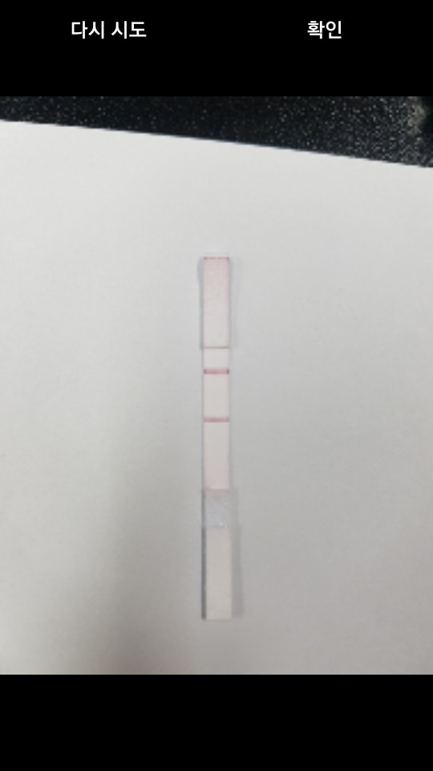
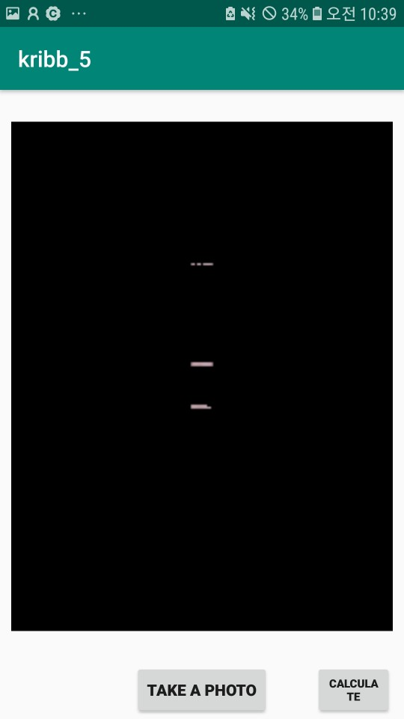
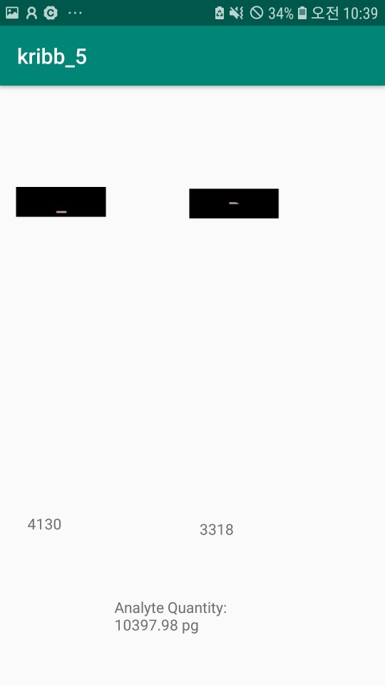
Screenshots for 10 ng/mL with two light conditions
- Light condition #1

Slide 2
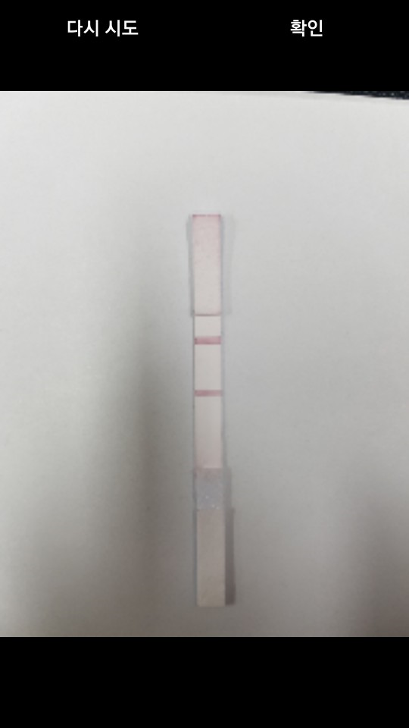
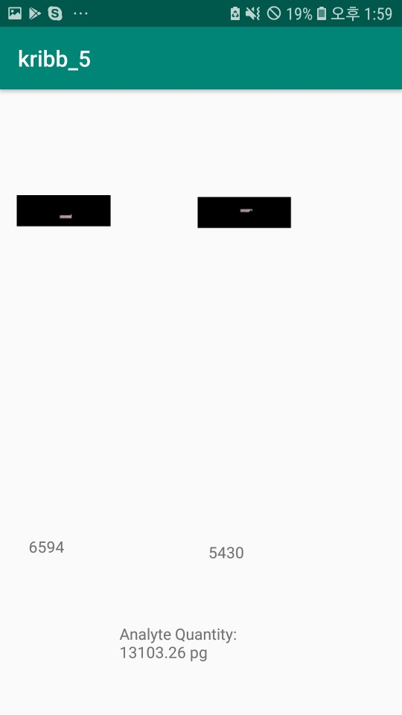
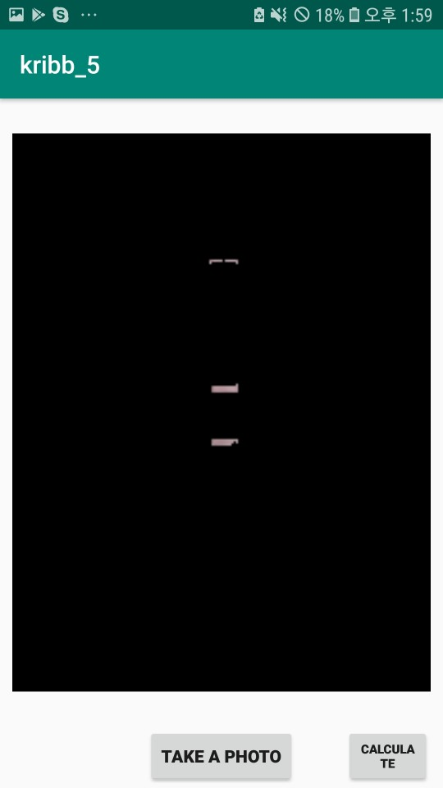
Screenshots for 10 ng/mL with two light conditions
- Light condition #1

Slide 3
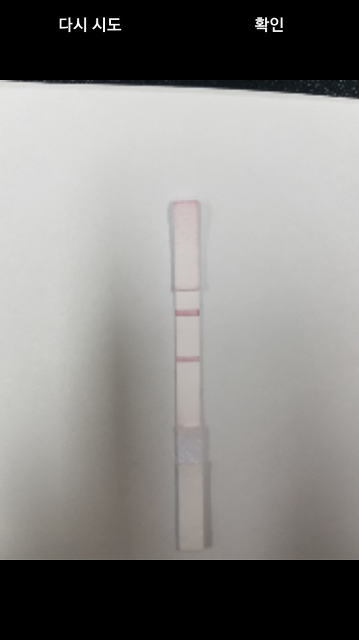
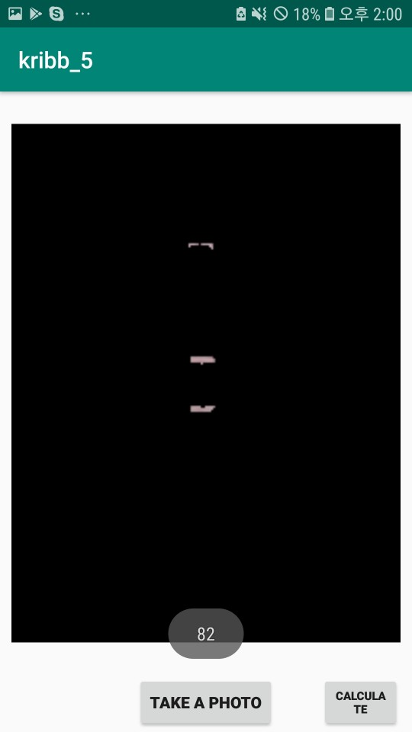

Screenshots for 10 ng/mL with two light conditions
- Light condition #1 – 36W LED lamp

Slide 4
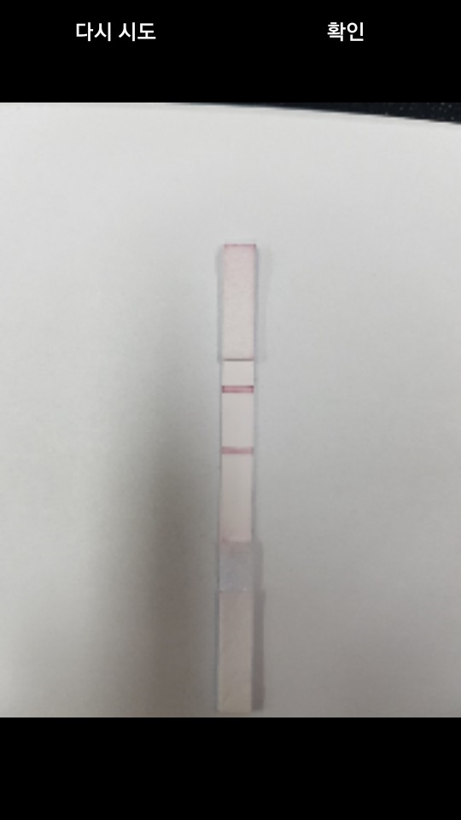
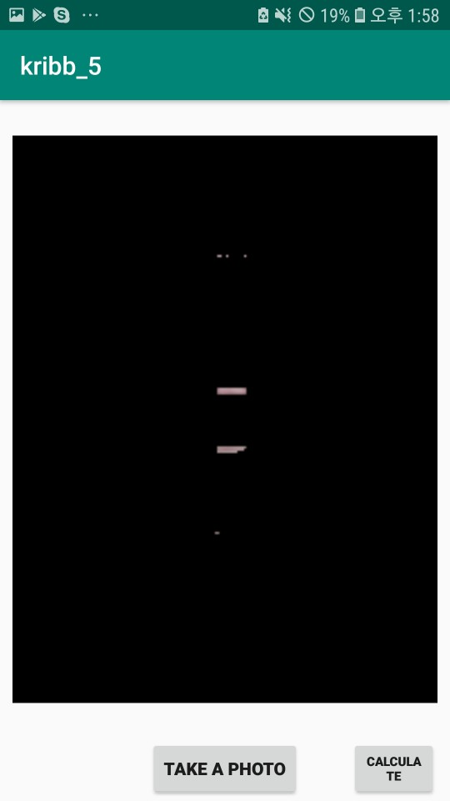

Screenshots for 10 ng/mL with two light conditions
- Light condition #1

Slide 5
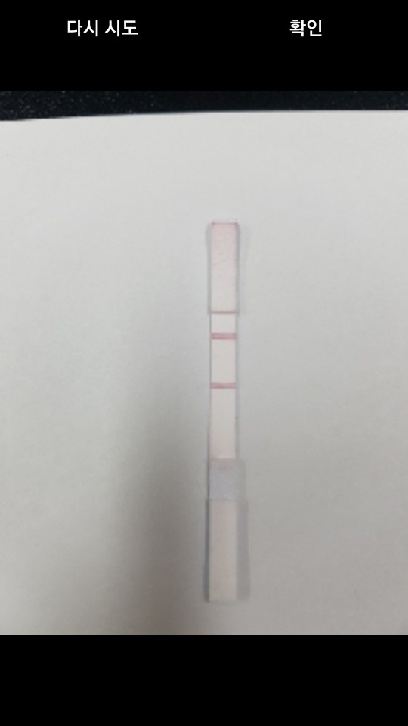
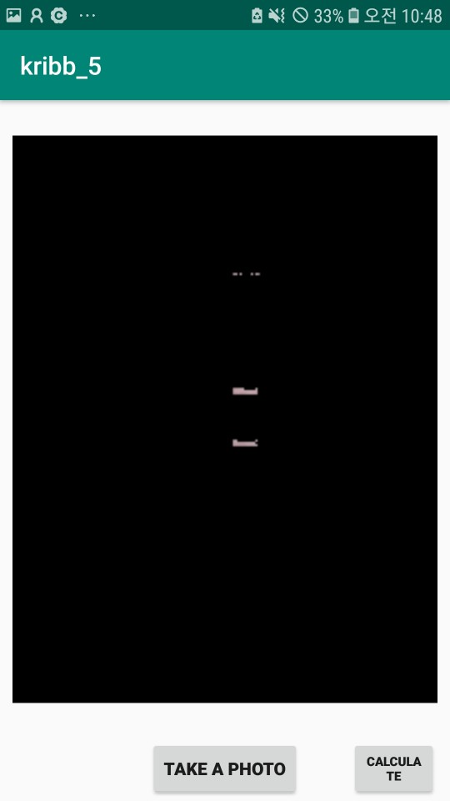

Screenshots for 10 ng/mL with two light conditions
- Light condition #1

Slide 6
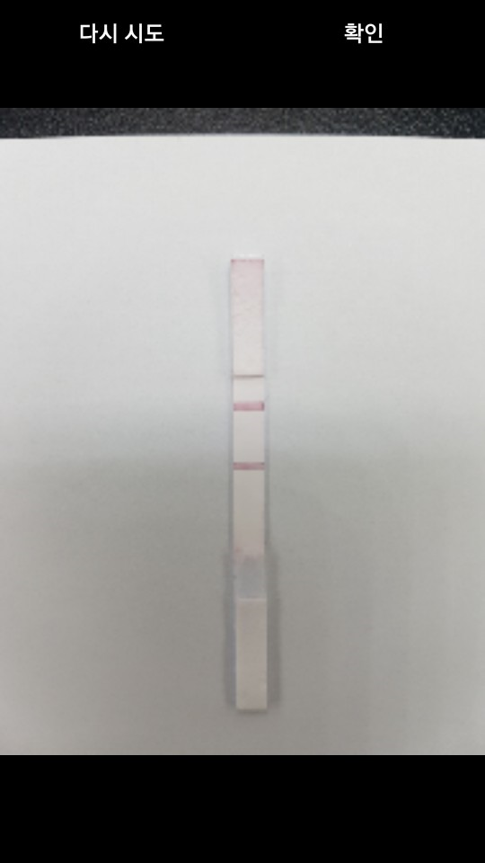

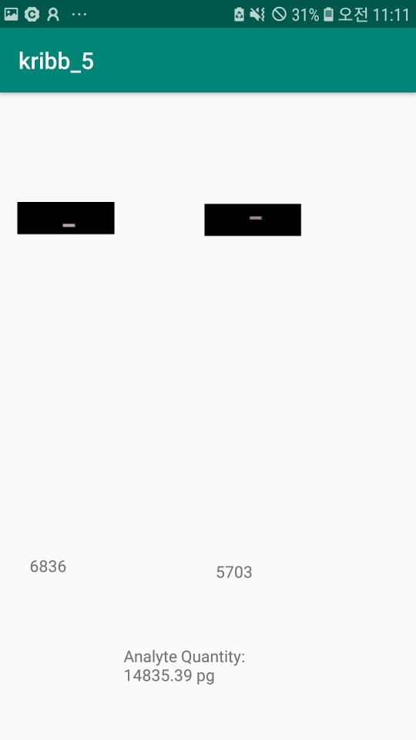
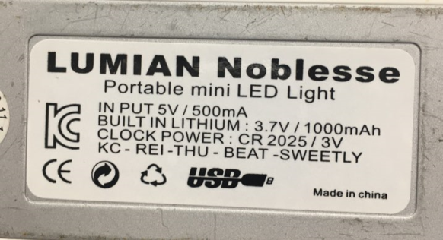
Screenshots for 10 ng/mL with two light conditions
- Light condition #2 – Table lamp
Table lamp information

Slide 7
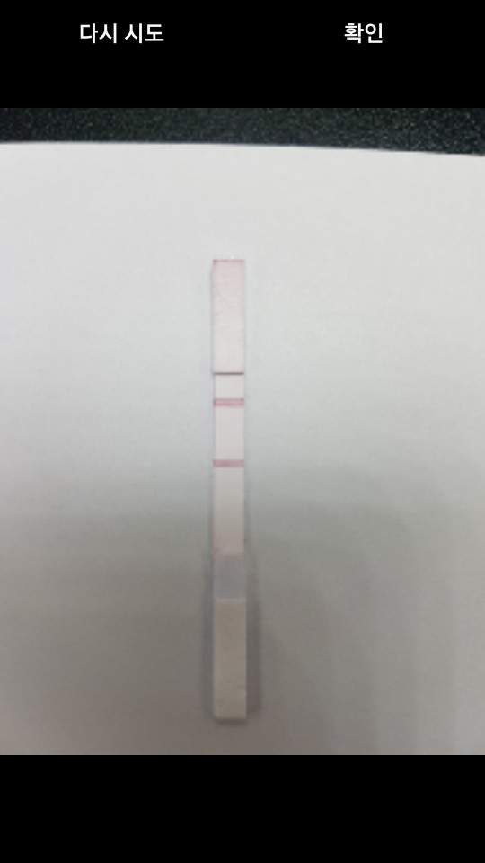
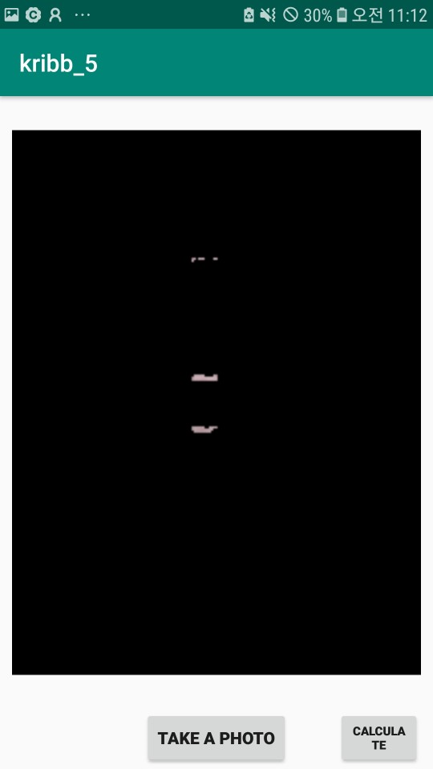

Screenshots for 10 ng/mL with two light conditions
- Light condition #2

Slide 8
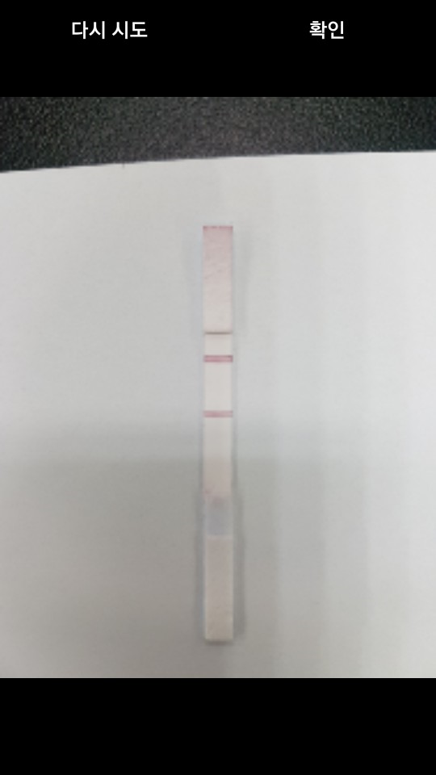

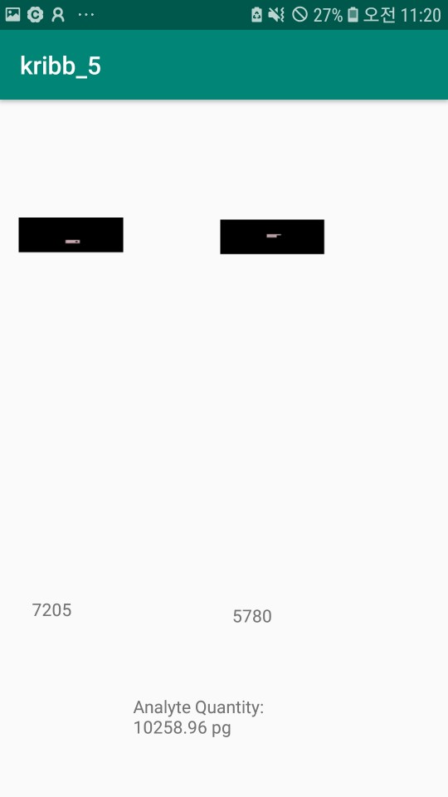
Screenshots for 10 ng/mL with two light conditions
- Light condition #2

Slide 9
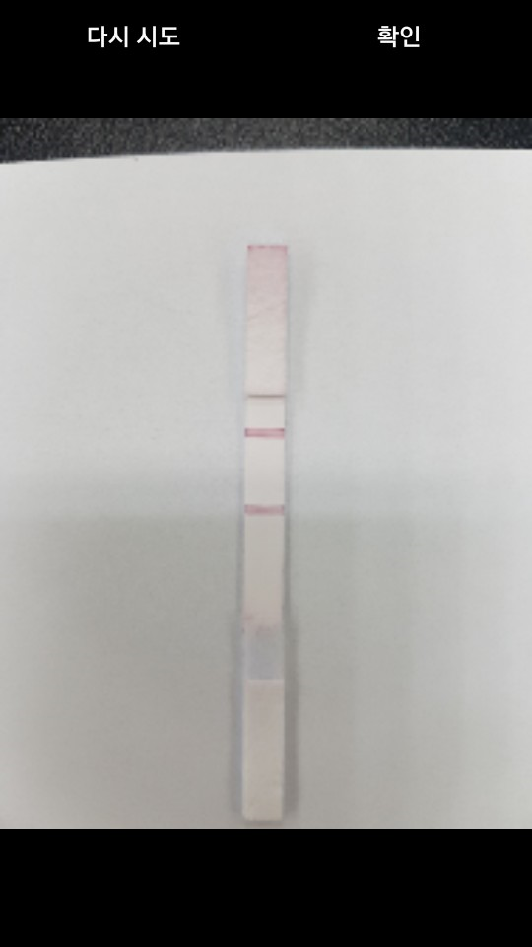


Screenshots for 10 ng/mL with two light conditions
- Light condition #2

Slide 10
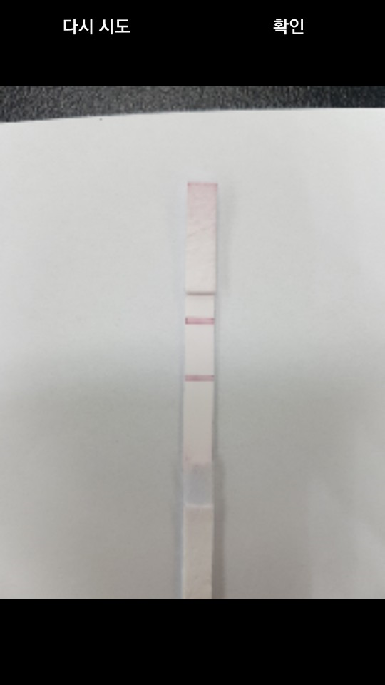


Screenshots for 10 ng/mL with two light conditions
- Light condition #2

Slide 11
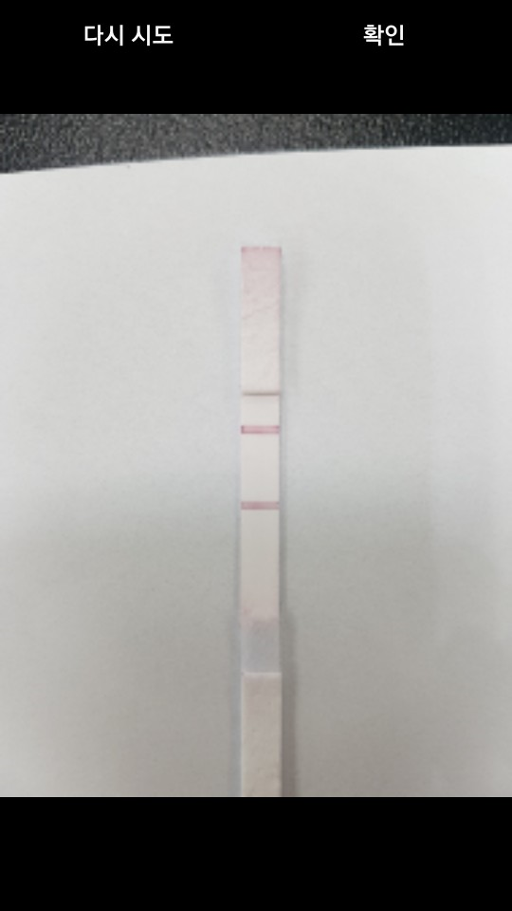


Screenshots for 10 ng/mL with two light conditions
- Light condition #2

Slide 12


